Slide 1

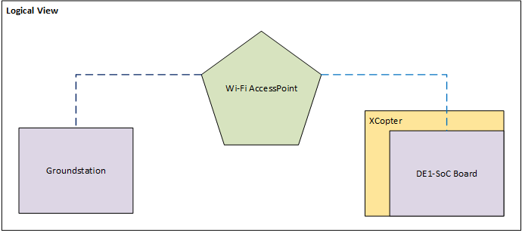
The X-Copter Project: Wi-Fi
University of
Applied Sciences
Wi-Fi Connectivity
TEXTtextTEXT

